Slide 1
The Globalization Origins of Autocratic Rise
Engaged Reformers, Autocratic Advantages, and the Post-Cold War Reversal
George Yean
PhD Candidate
Harvard University
APSA, 2025

Slide 2
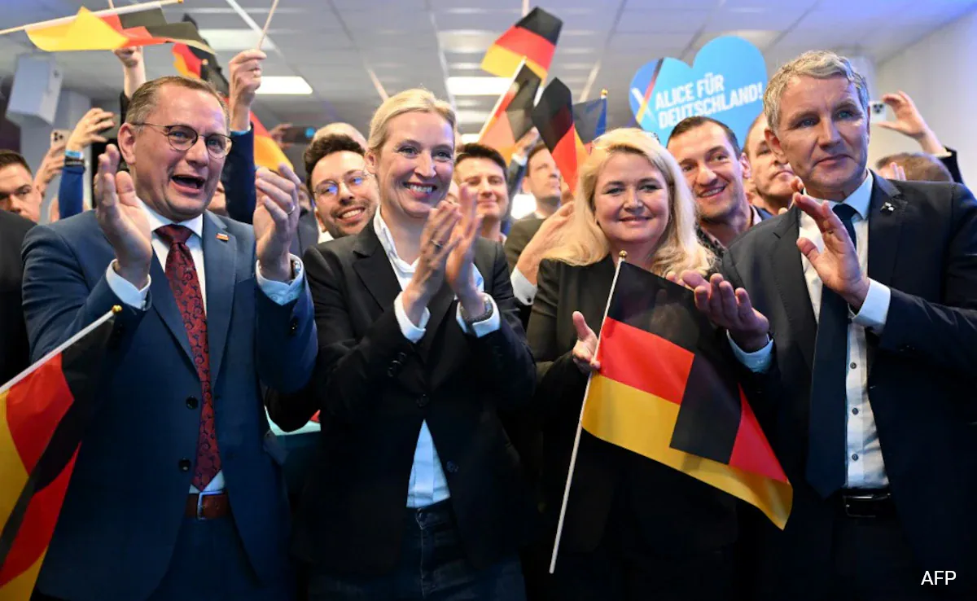
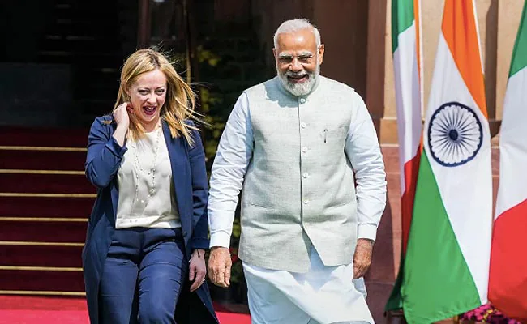
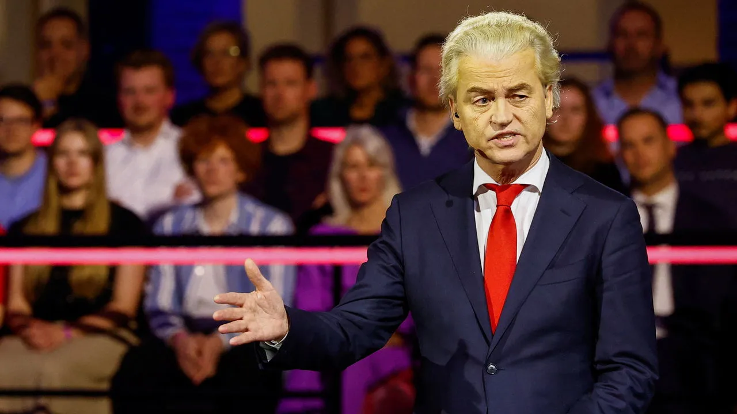
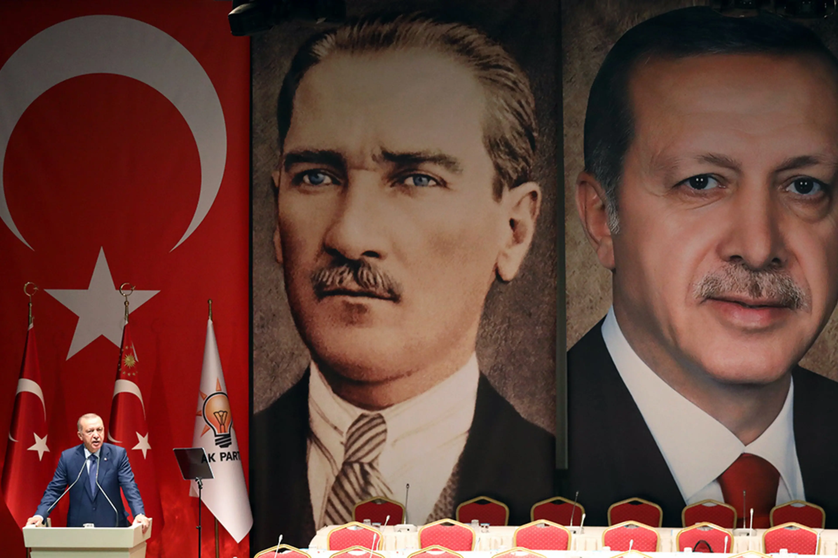
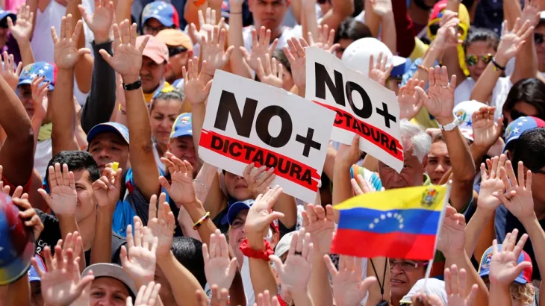

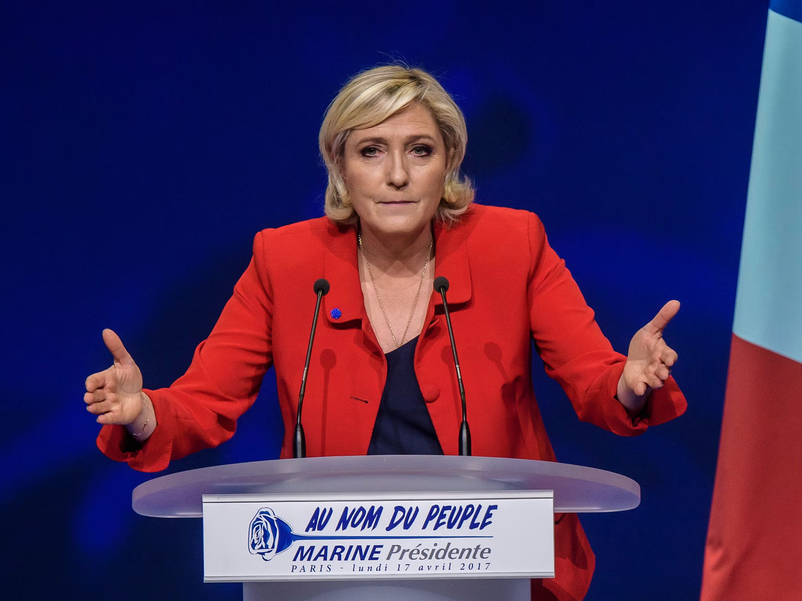
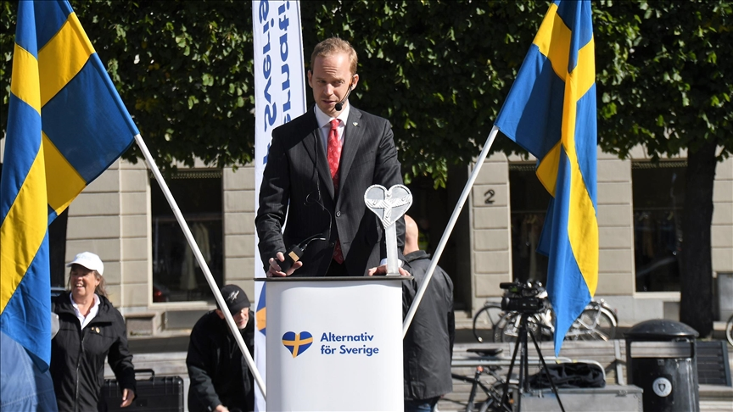

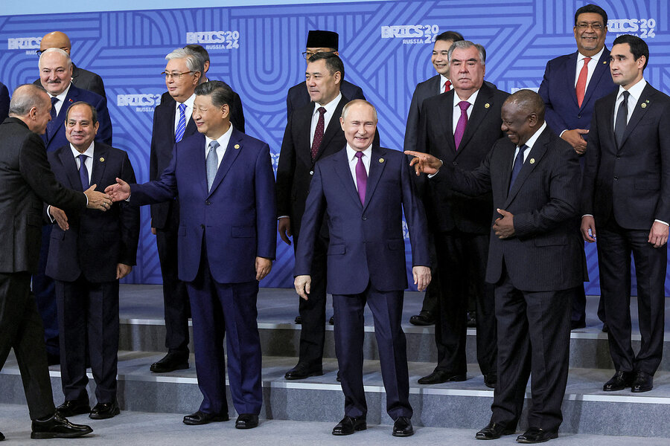
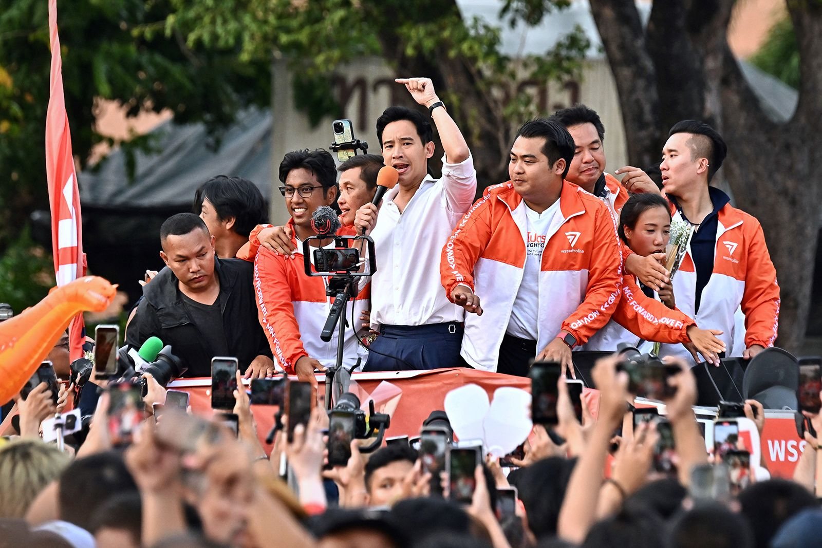
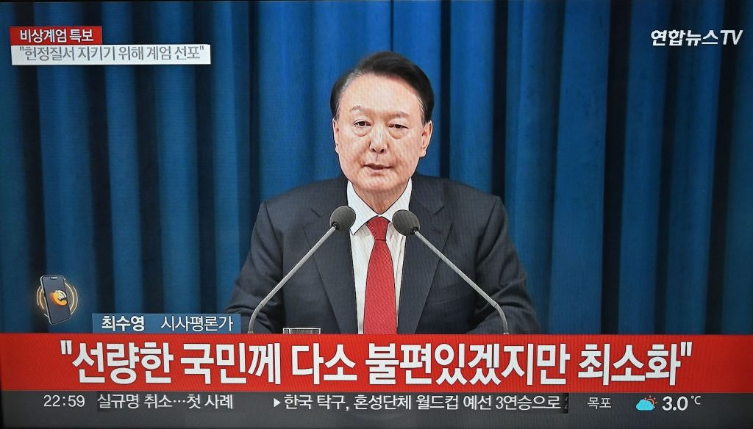
Democratic Backsliding
/Crisis
Notes:
“trade and economic endeavour should be conducted with a view to raising standards of living, ensuring full employment and a large and steadily growing volume of real income and effective demand, developing the full use of the resources of the world and expanding the production and exchange of goods.” Institutional development frequently depends on prior outcomes ("path dependence") and evolutionary forces. As institutions evolve, rational design choices can arise in two ways. First, participants may modify institutions in stages, by making purposeful decisions as new circumstances arise, by imitating features from other institutions that work well in similar settings, or by designing explicit institutions to strengthen tacit cooperation. Second, institutions may evolve as states (and other international actors) select among them over time. States favor some institutions because they are better suited to new conditions or new problems and abandon or downplay those that are not. For example, the obvious place to handle intellectual property rights would seem to be the World Intellectual Property Organization, but the countries that generate most patents chose to move the issue to the WTO because it offered better enforcement mechanisms. Thus the institutionalization of the issue evolved significantly, not because an older institution was modified, but because another one offered a better institutional design.

Slide 3
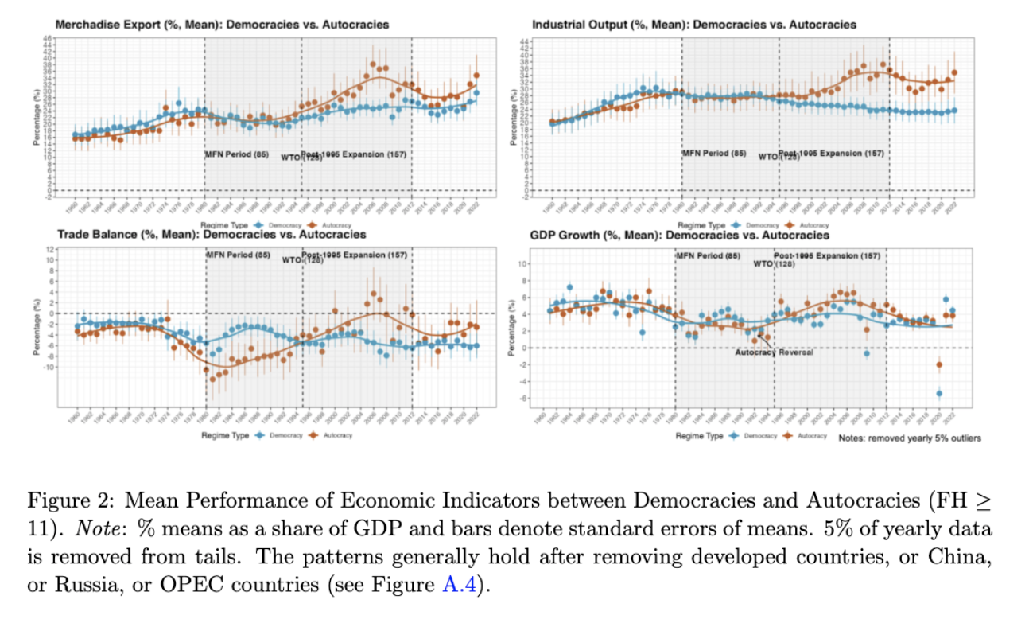
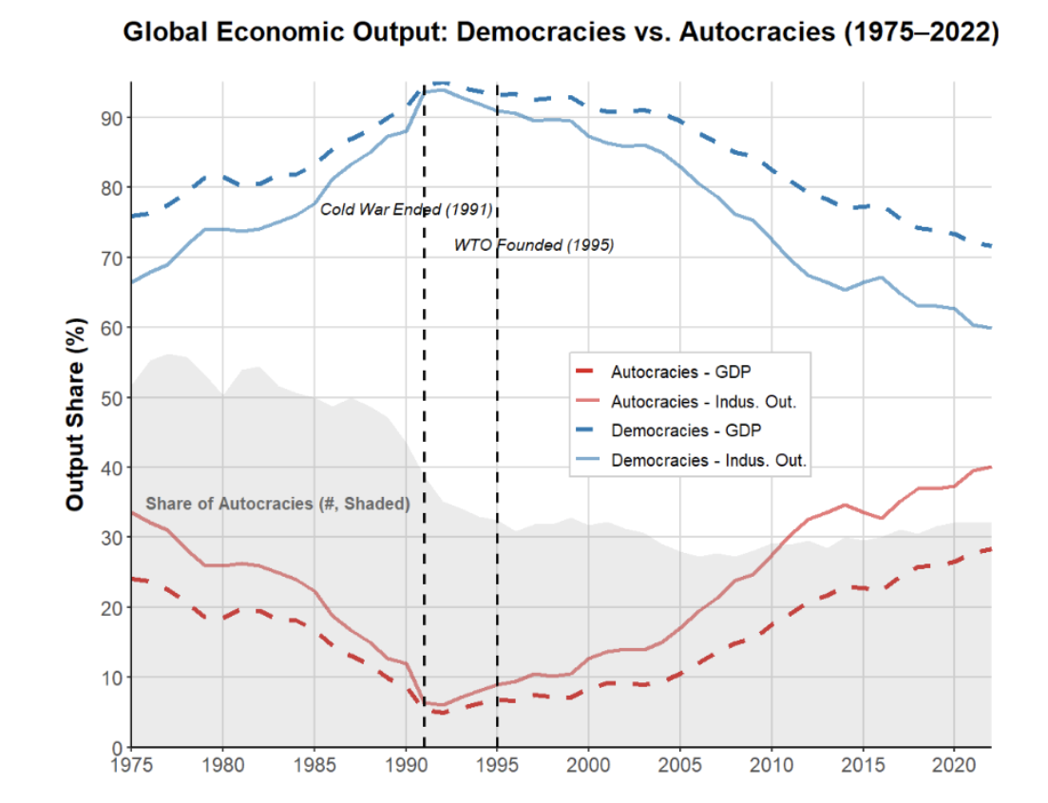
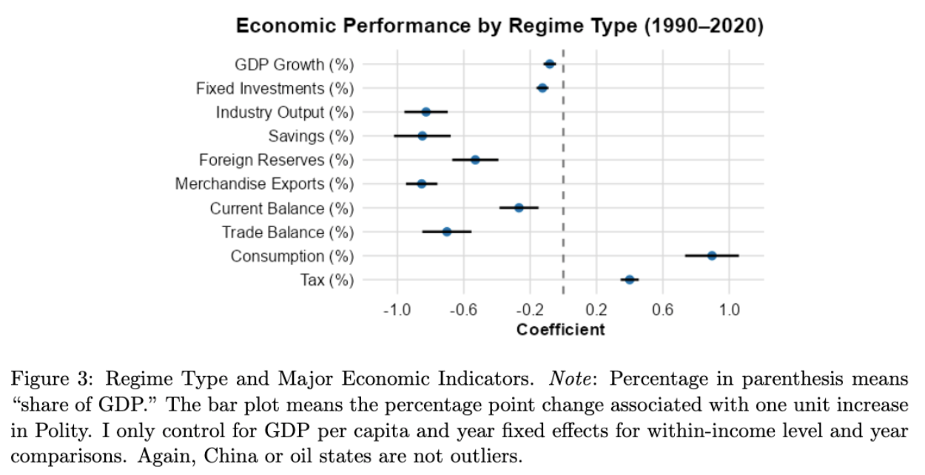

Meanwhile: Autocratic Rise

Slide 4
"With the spectacular economic growth under nondemocracy in China, the eclipse of the Arab Spring, and the recent rise of populist politics in Europe and the United States, the view that democratic institutions are at best irrelevant and at worst a hindrance for economic growth has become increasingly popular in both academia and policy discourse.
–– Acemoglu et al. 2019

Slide 5

What Does Literature Tell?
Growth: mixed
(Przeworski et al. 2000; Barro 1996)
Exports: democracy is better (Eichengreen and Leblang 2007; Levchenko 2007; Yu 2010)
Institutional theory: inclusiveness is better
(Acemoglu et al. 2001; Acemoglu et al. 2012; North 1990)
Mostly use pre-2000 data
Primarily on internal mechanisms
Ignore contextual change: post-1990 globalization
Notes:
But nearly end of 1980, autocracies lost out in computerization.

Slide 6
Contextual Change
Pre-1990 (Cold War):
Constrained economic exchange, regional blocs
Many were closed or inward-looking (e.g., ISI), “trade skepticism” (Sachs and Warner 1995)
Stagnation or crisis in the 1980/90s (autocracies lost out in computerization age)
Post-1990:
“Hyper-globalization”: trade, finance, GVC …
Market-oriented and outward-looking reforms
Engagement by West (e.g., WTO): credibility, market, capital, technology … (Arias et al. 2018; Baccini and Urpelainen 2015; Baldwin 2016; Hafner-Burton and Schneider 2019).
➔ Important for autocracy: low internal demand & credibility
Notes:
Fundamental problems for aut even with smart leaders: weak demand, low credibility if no trade and inst reform.

Slide 7
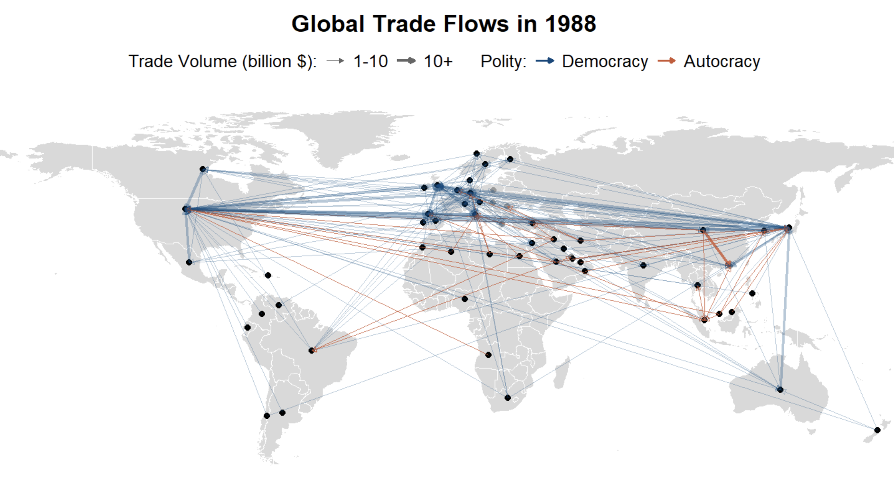
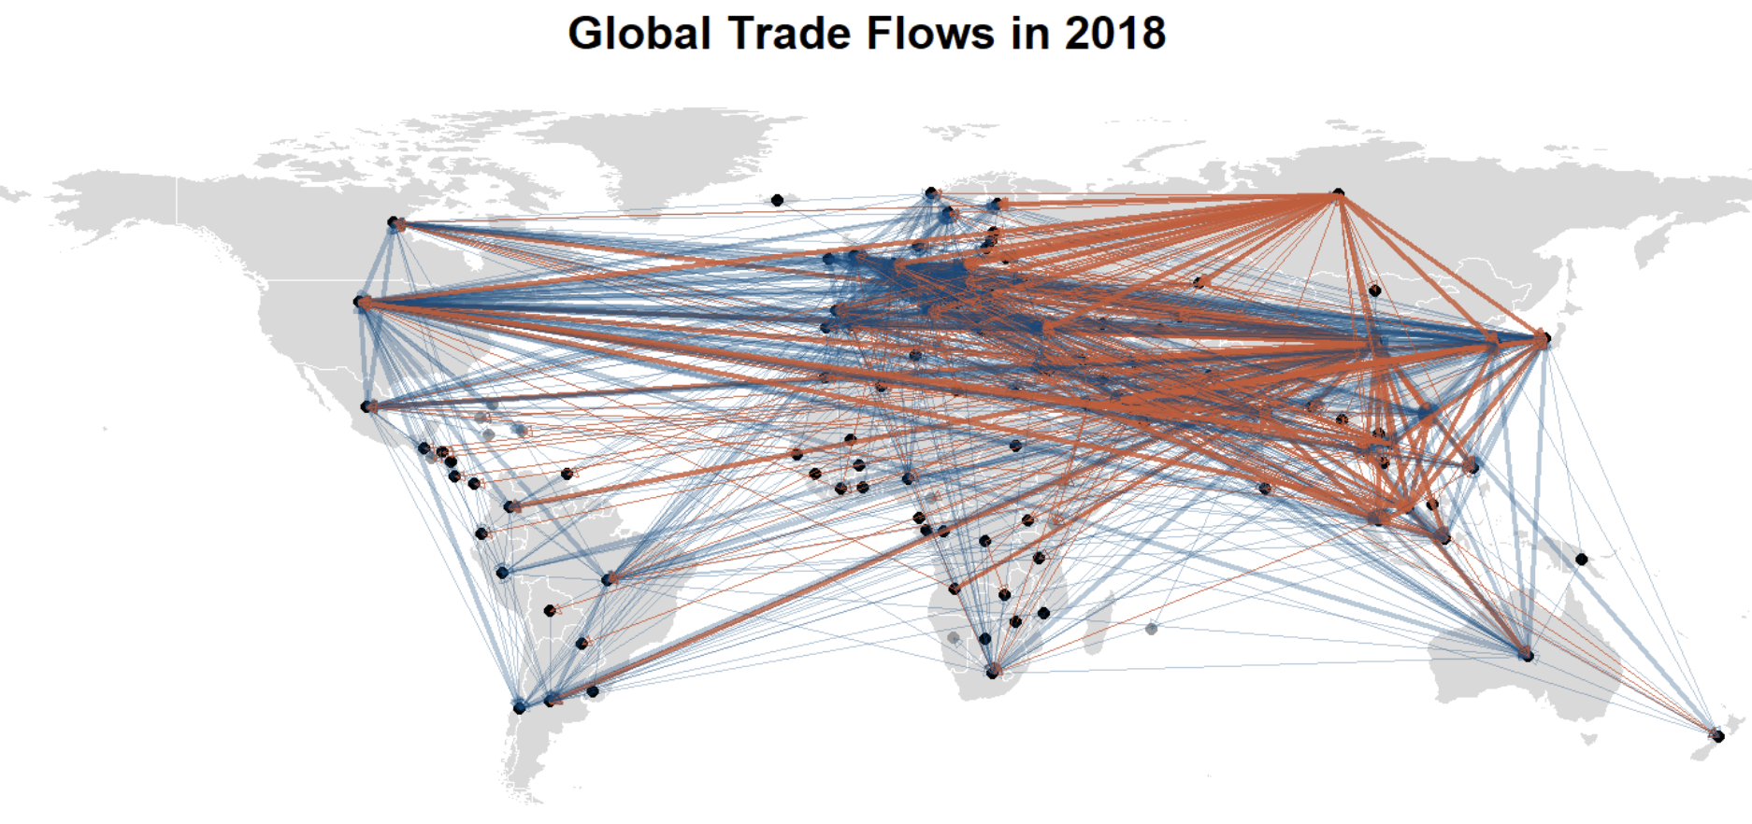
Example: Trade

Slide 8
Against the Backdrop: Argument
A special form of autocratic regime types:
Economically reformed and engaged (e.g., WTO): “engaged reformers” ➔ scope condition
Stronger inst./non-inst. abilities in competing for external demand than its democratic “counterfactual”
Although weaker in internal demand (e.g., due to non-inclusive political institutions) ➔ fundamental problem

Slide 9
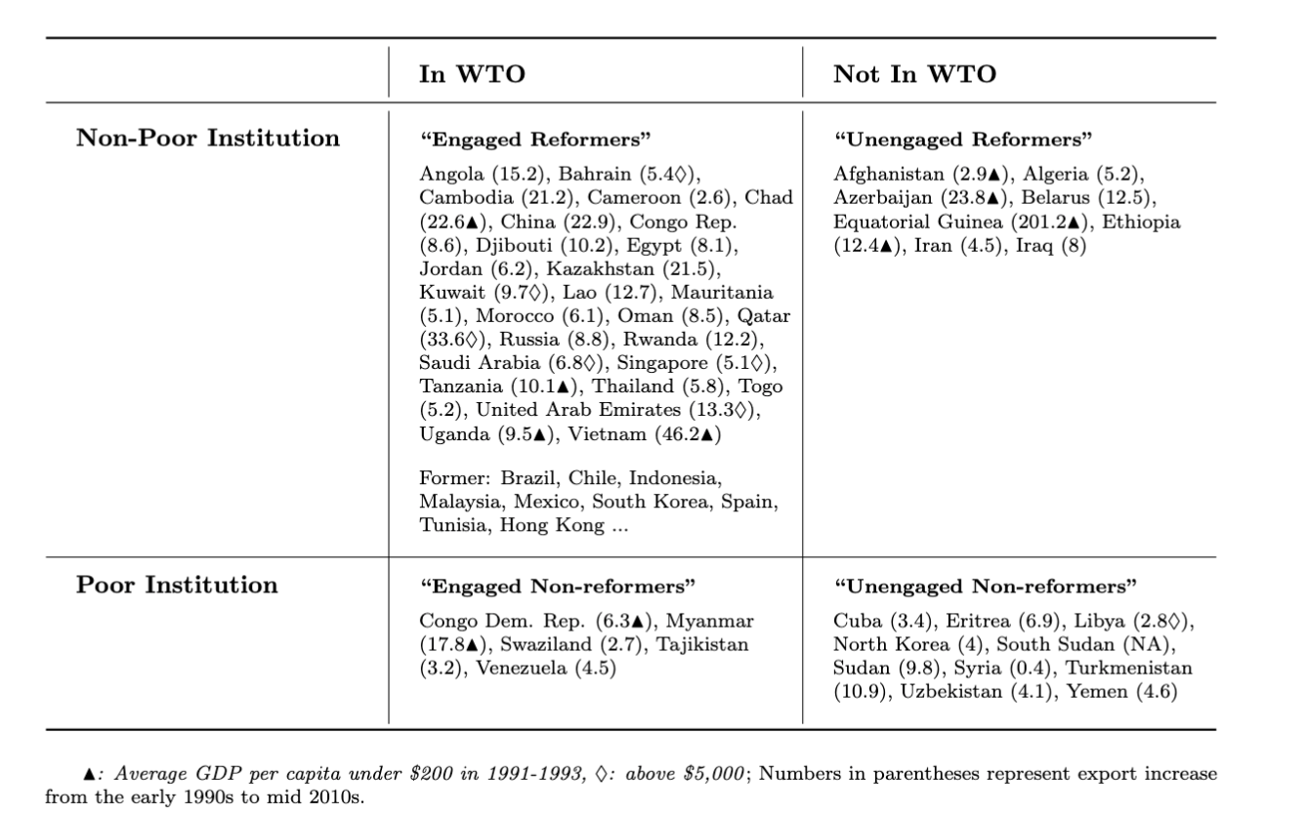
“Engaged Reformer”: Face Validation
*Dozens of stars in East/Southeast Asia
*Other cases (to varied degrees):
… Pinochet’s Chile (1980/90s); Franco’s Spain (1959–1974); Junta’s Brazil (1968-1973); Salazar’s Portugal (1960s); PRI’s Mexico (1980/90s); Fujimori’s Peru (1993–1999); Trujillo’s Dominican Re- public (1950/60s); Colombia (1958-1974); Argentina (1966-83); dos Santos’ Angola (2002–2008); Ben Ali’s Tunisia (1990–2010); Kagame’s Rwanda (2000–2019); Botswana (1966–1980); Zenawi’s Ethiopia (2004–2012); Obiang’s Equatorial Guinea (1996–2008); Mubarak’s Egypt (1990s–2005); Mohammad’s Morocco (1999–2008) …

Slide 10
New Context: Globalized Economy (vs. semi/closed)
Shifts development focus outward: market/tech/capital
Local factors globally comparable and liquidatable
Earlier trade theory: comparative advantage, specialization (H-O/R-V model)
Newer trade theory: scale, firm selection, GVC/FDI (Krugman 1979; Grossman and Helpman 1991; Melitz 2003; Antras 2015) exports drive income/productivity/innovation (Atkeson & Burstein 2010; Burstein & Melitz 2013)
Creates large room for self-interested policies
One-time gain, long-term uncertain (Garret 2000); 10% explained by comp. adv. (Osgood 2017)
Assumptions may not hold: balanced trade/exo. imbalance, no friction, effective f/x ⇒ strategic trade theory, developmental state model …
Interventions can create “artificial cost advantage” (see modes in Eaton & Kortum 2002; Arkolakis et al. 2018; Melitz 2003; Costinot et al. 2013; Epifani & Gancia 2017)
Notes:
the global trade system, combined with floating exchange rates and freer capital flows

Slide 11
Theory: Autocratic Advantages in Globalized Economy
Since 80/90s, neoliberal reforms often rely on (semi)authoritarian measures (Bruff 2014)
Reform-and open scenario: disadvantage ⇒ advantage
Centralized power: less deliberation, respond swiftly, resist shocks, consistent planning, state support (Clegg et al. 2018; Haggard 1990; Kim 2018; Wade 1990; Wu 2016)
Weak institutional constraints (ex ante): lack opposition, large win-set, divert resr. to indus, attract MNCs, manipulate policies (Allen & Ge working; Brune et al. 2001; Steinberg and Malhotra 2014; Lipscy 2018; Putnam 1995)
Weak accountability (ex post): market/MNC-favoring policies, resist redistribution, suppress labor/env/corporatist, impose austerity/saving (Quinn and Woolley 2001; Sah 1991; Zakaria 1997; Rodrik 1999; Manger and Sattler 2015; Feierherd 2024; Krueger 1974)
Other: resource endowment, consumption-discouraging culture …
Notes:
-These measures, partly because they work, were used to manage resistance, enforce compliance, and stabilize systems that prioritize market logic
-some regime characteristics that may otherwise be disadvantages in a relatively closed economy can indeed become advantageous, since the goal is about competing for external demand
-In contrast, many Latin American democracies even have stricter labor regulations than OECD countries (Feierherd 2024)

Slide 12
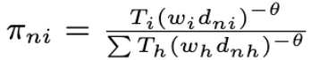
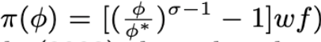
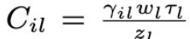
e.g. Trade Models
Eaton & Kortum 2002:
Melitz 2003:
Arkolakis et al. 2018:
Notes:
-These measures, partly because they work, were used to manage resistance, enforce compliance, and stabilize systems that prioritize market logic
-some regime characteristics that may otherwise be disadvantages in a relatively closed economy can indeed become advantageous, since the goal is about competing for external demand
-In contrast, many Latin American democracies even have stricter labor regulations than OECD countries (Feierherd 2024)

Slide 13
Globalization: Taking “Autocratic Adv.” Seriously
Three determinants:
Reformed Institutions (PR protection, RoL …)
Expanded external markets (WTO expansion)
Active state policy (infra., indus., trade …)
Growth/Development theories:
exogenous growth (Solow 1957)
endogenous growth (Romer 1986)
institutional theory (North 1990; Acemoglu et al. 2005) developmental state (Evans 1995; Haggard 1990; Rodrik 2004)

Slide 14
Applying the Theory
Many transformations of globalization:
Trade, finance, migration, governance, security, environment, culture, norms …
Two most trade-enhancing ones: (North 1990; Romer 1986; Haggard 1990)
Trade integration
Domestic reform
Meet scope condition

Slide 15
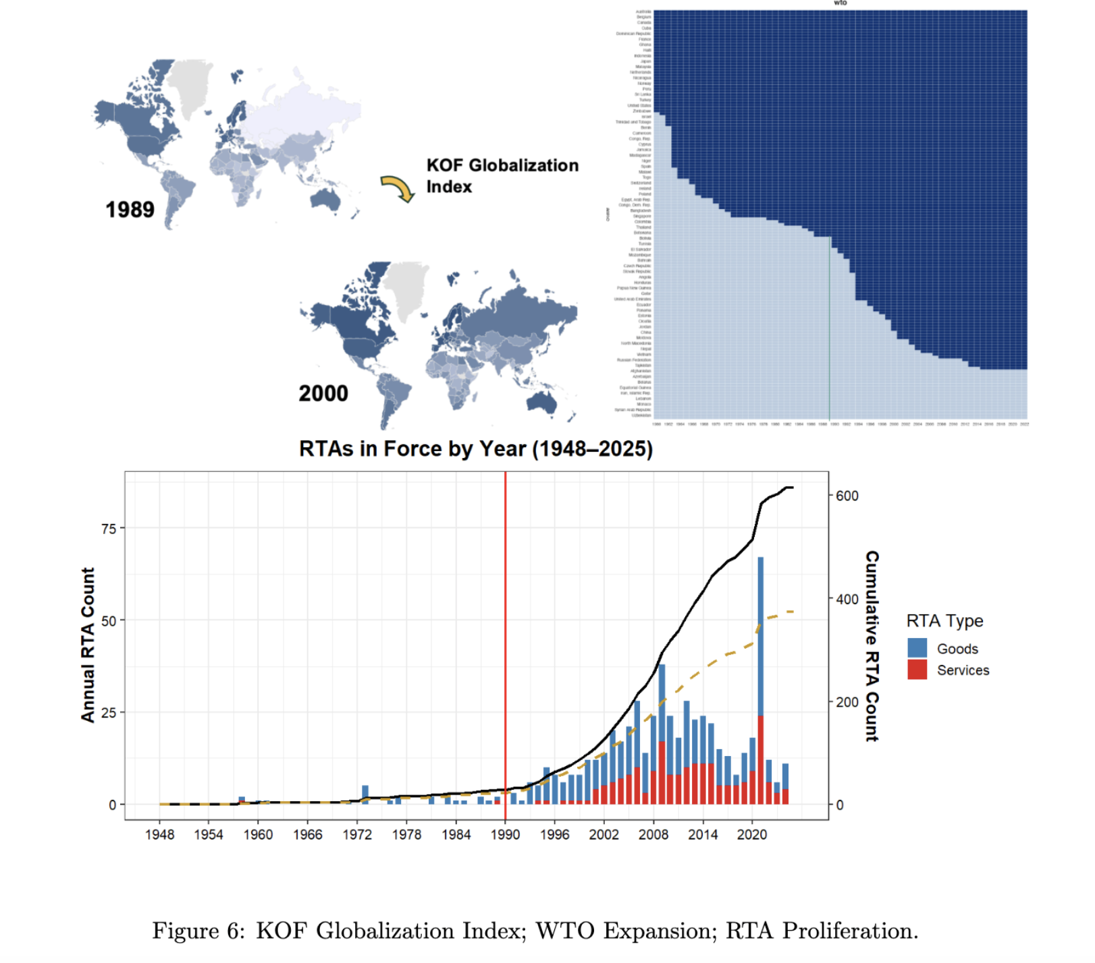
Trade Integration
“Hyper-globalization” (Rodrik 2018)
WTO – “the most heralded commercial agreement in history” (Bagwell and Staiger 2002; Goldstein et al. 2007)
Other: MFN/PTA, RTA
IOs enhance credible commitments
“by 2000, most post-communist countries reoriented trade to Western markets” (Aslund 2012)

Slide 16
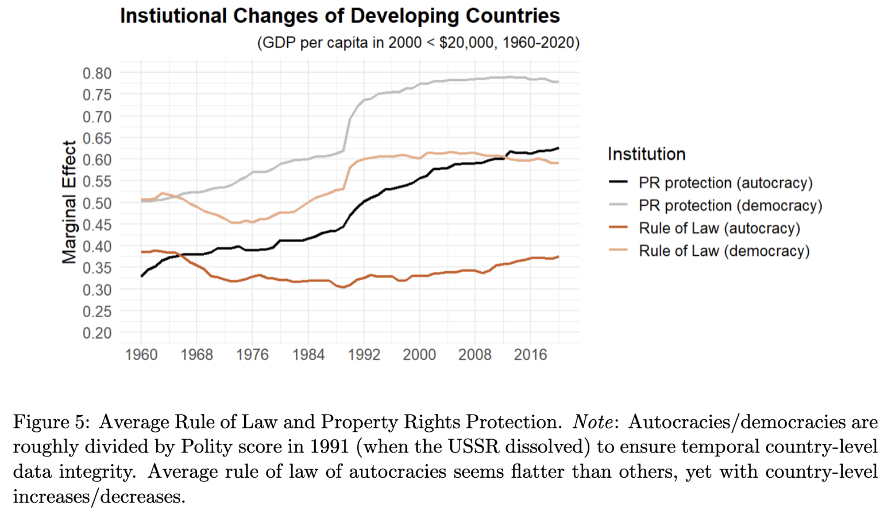
Institutional Reform
Both autocracies and democracies
Market-oriented & institutional reform
PR protection and RoL most important (Acemoglu et al. 2005)
E.g. Turkmenistan vs. Azerbaijan

Slide 17
Empirics

Slide 18
DV (regarding External Demand)
Exports
Gain in income/productivity/innovation (Bernard et al. 2018; Helpman and Krugman 1985)
r = 0.74 (avg. growth rate, 1992-2015)
External Balance:
Persistence indicates structural/development issues; redistribution of demand (Blanchard and Milesi-Ferretti 2009; Obstfeld and Rogoff 2009; Chinn and Ito 2021)
r = 0.65 (avg. growth rate)
Success stories: East Asia, Core Europe, Gulf states
17 of 20 highest R&D expenditure countries
* trade has spill-over effects (e.g., China shock, dependency)

Slide 19
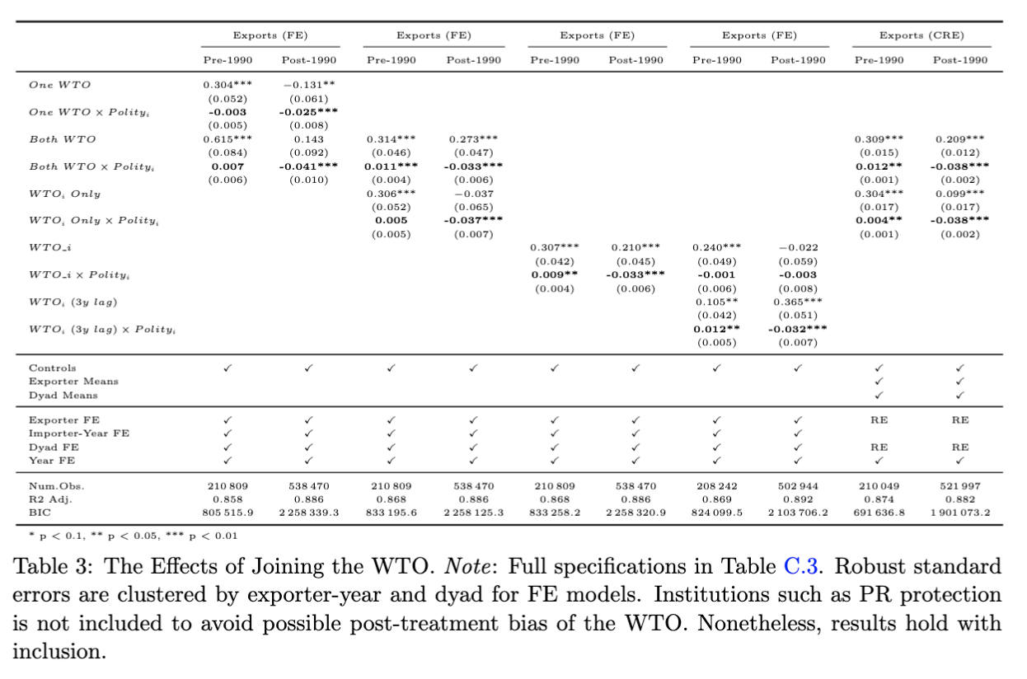
Result 1.1: WTO Accession
Gravity model:
(Anderson & van Wincoop 2003; Carnegie 2014; Goldstein et al. 2007; Rose 2004; Yu 2010 …)
CRE model:
(correlated random-effects)
Polity
-5: 45.5%
5: 4.6%
-10: 71%
10: -11.4%

Slide 20
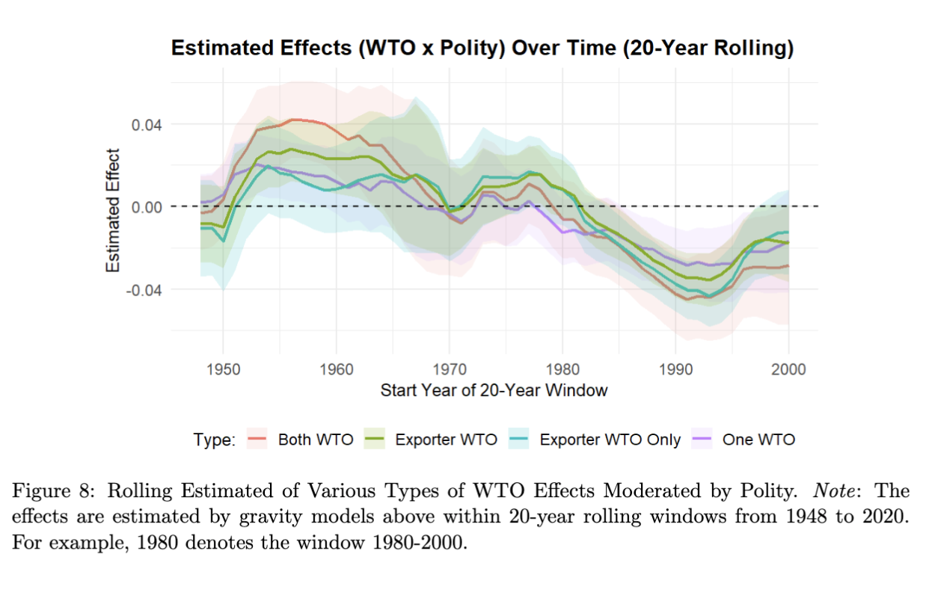
Result 1.1: WTO Accession

Slide 21
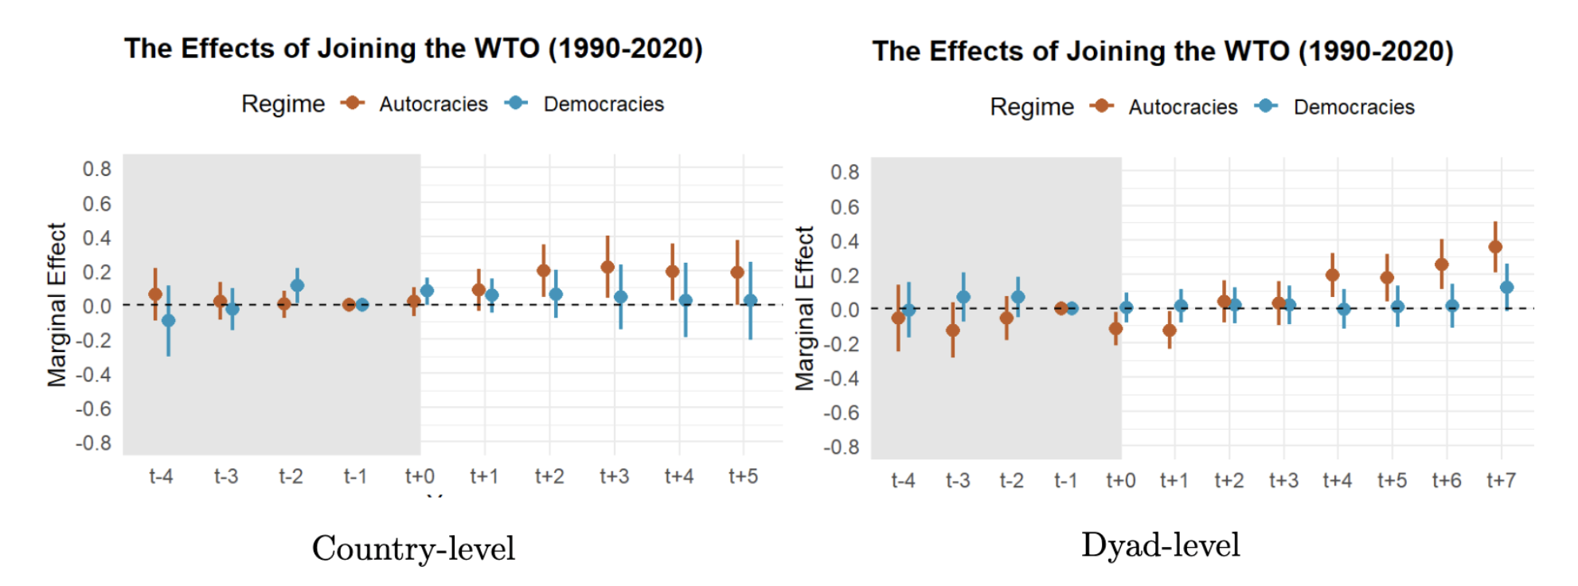
Result 1.1: WTO Accession
Sensitivity Analysis: Population (x250), GDP (x1000), Polity (x12)
DiD w/ matching:

Slide 22
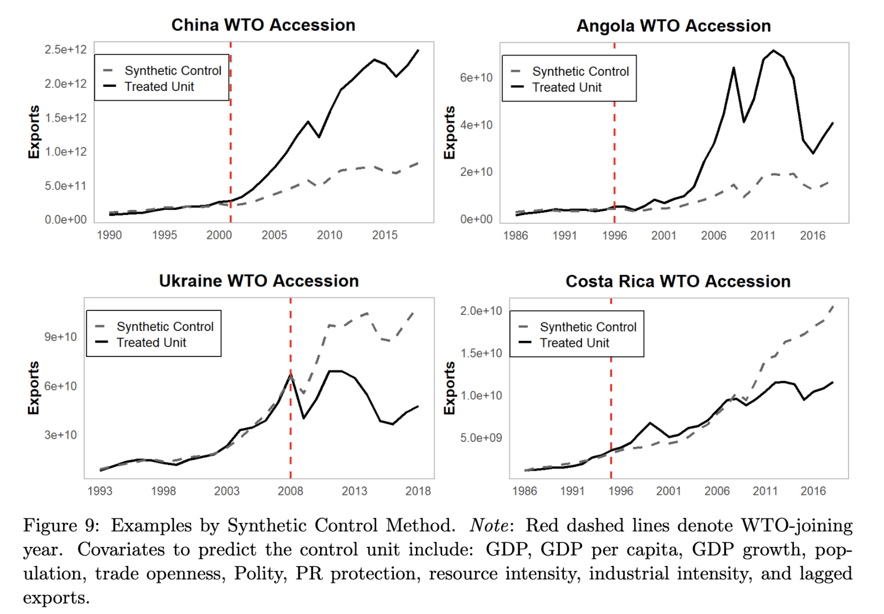
Result 1.1: WTO Accession
Examples, SCM:

Slide 23
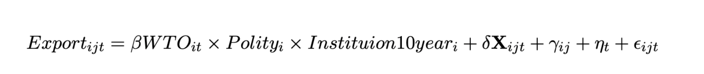
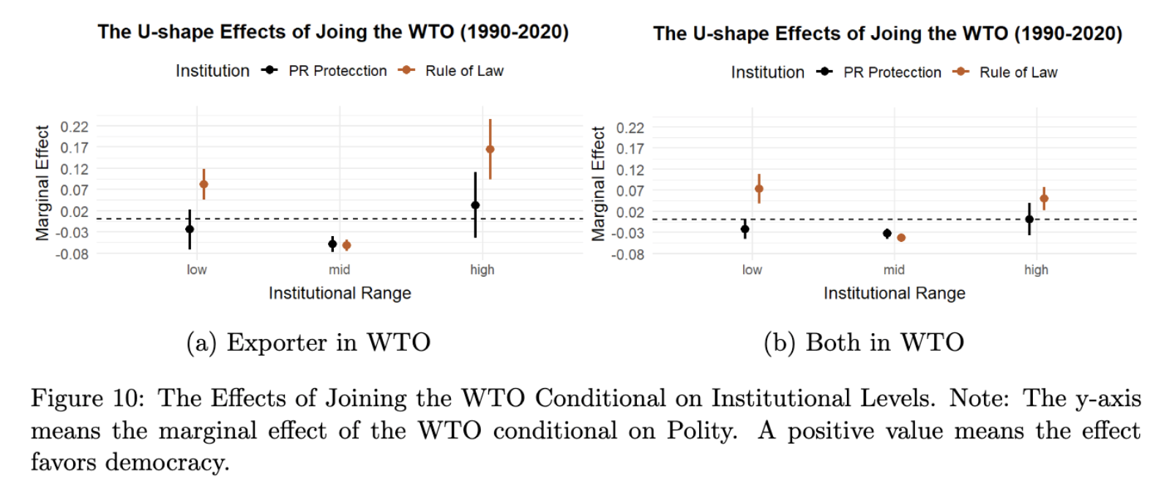
Result 1.2: Vary by Inst. (U-shape)
*inst. range dummy: lowest/highest 20th quantiles in 2000, w/ a ±10 ppt. variation.

Slide 24
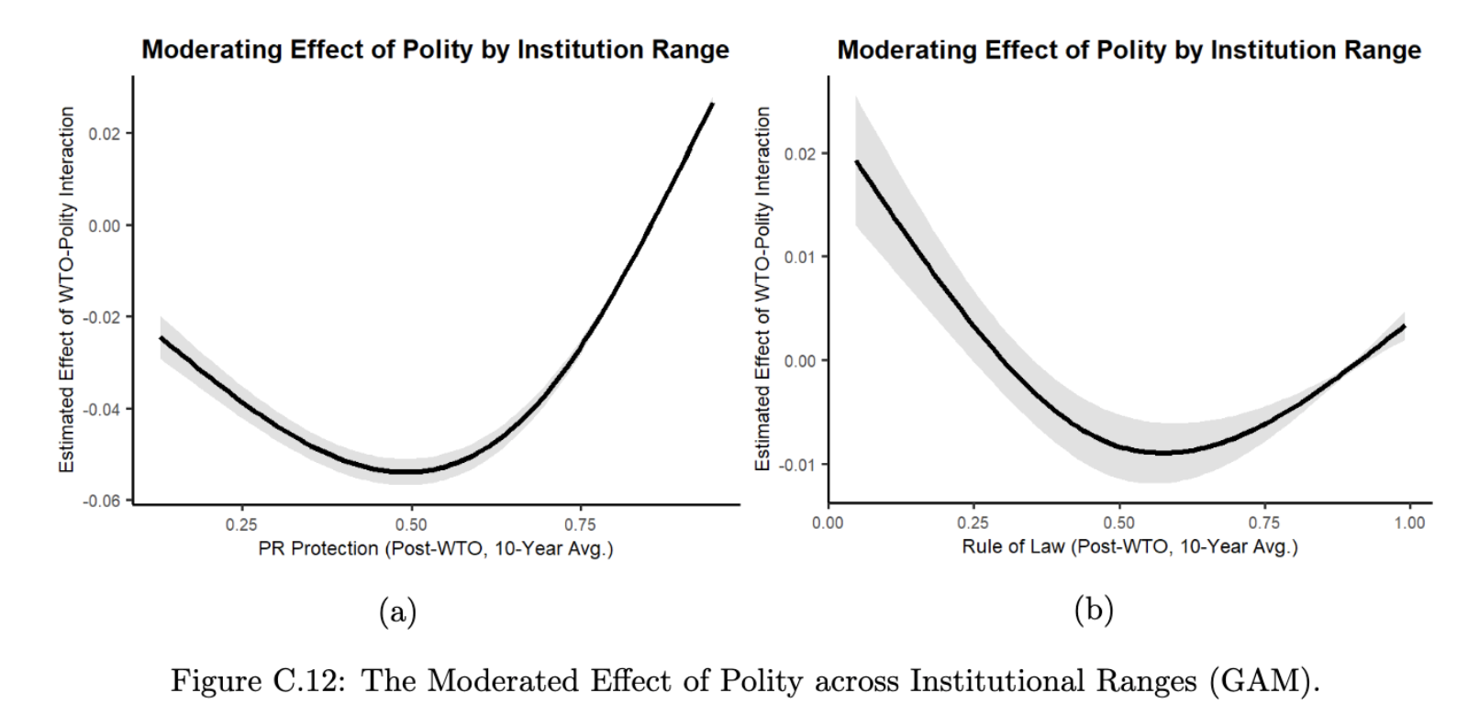
Result 1.2: by Inst.
Semi-parametric estimation (Generalized Additive Model)

Slide 25
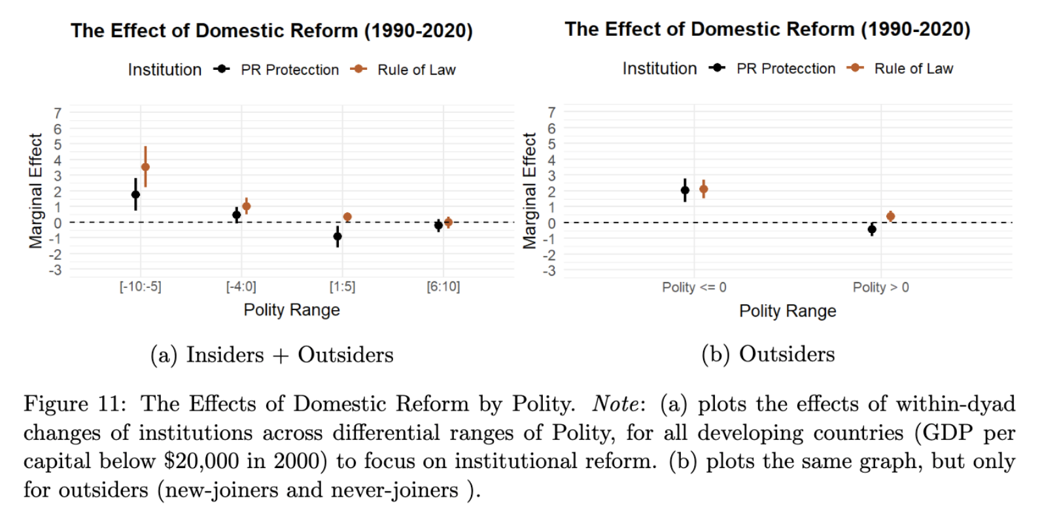
Result 2.1: Inst. Reform

Slide 26
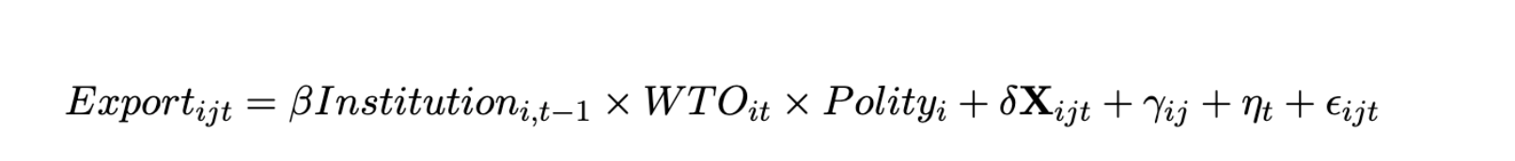
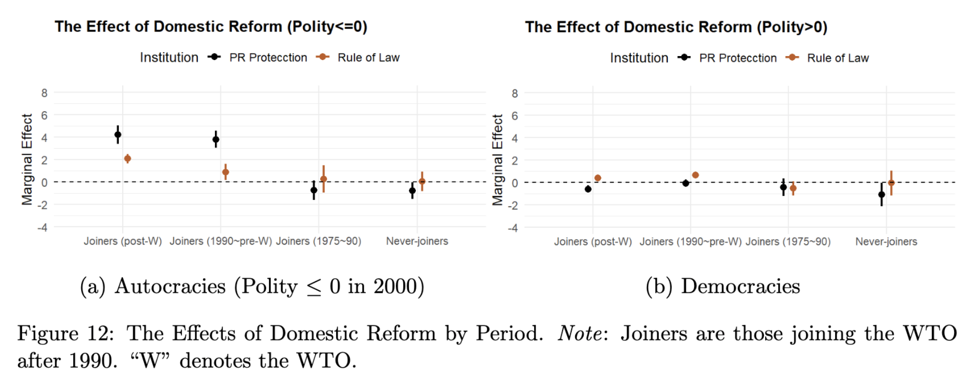
Result 2.2: Vary by WTO-related Period
Notes:
Although it’s hard to know the counterfactual of reform effect of when joiners are not in WTO, we can still get some effect

Slide 27
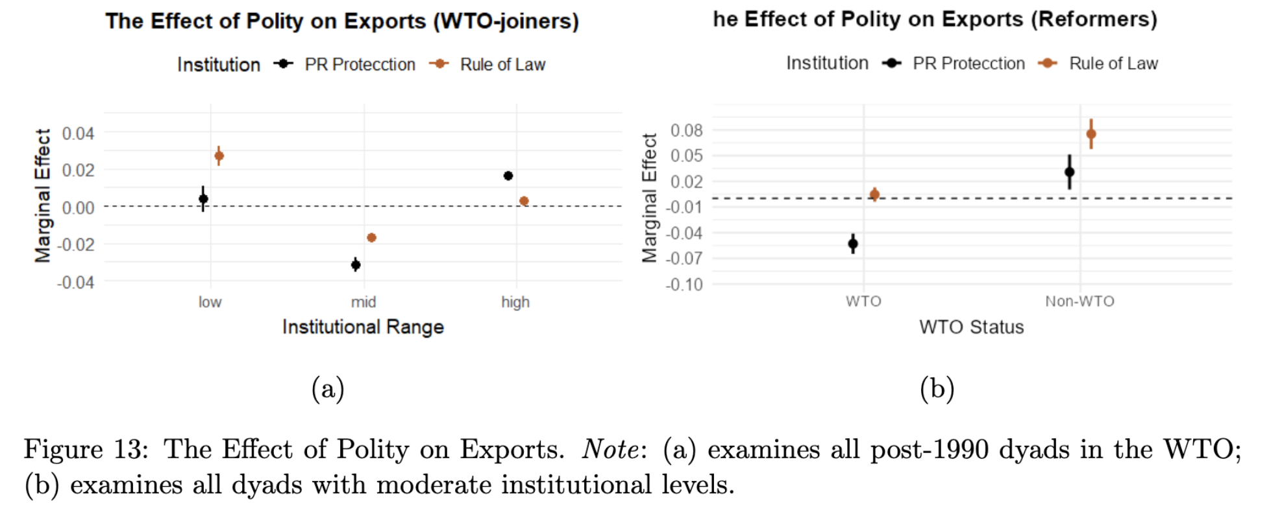
Result 3: Absolute Exports

Slide 28
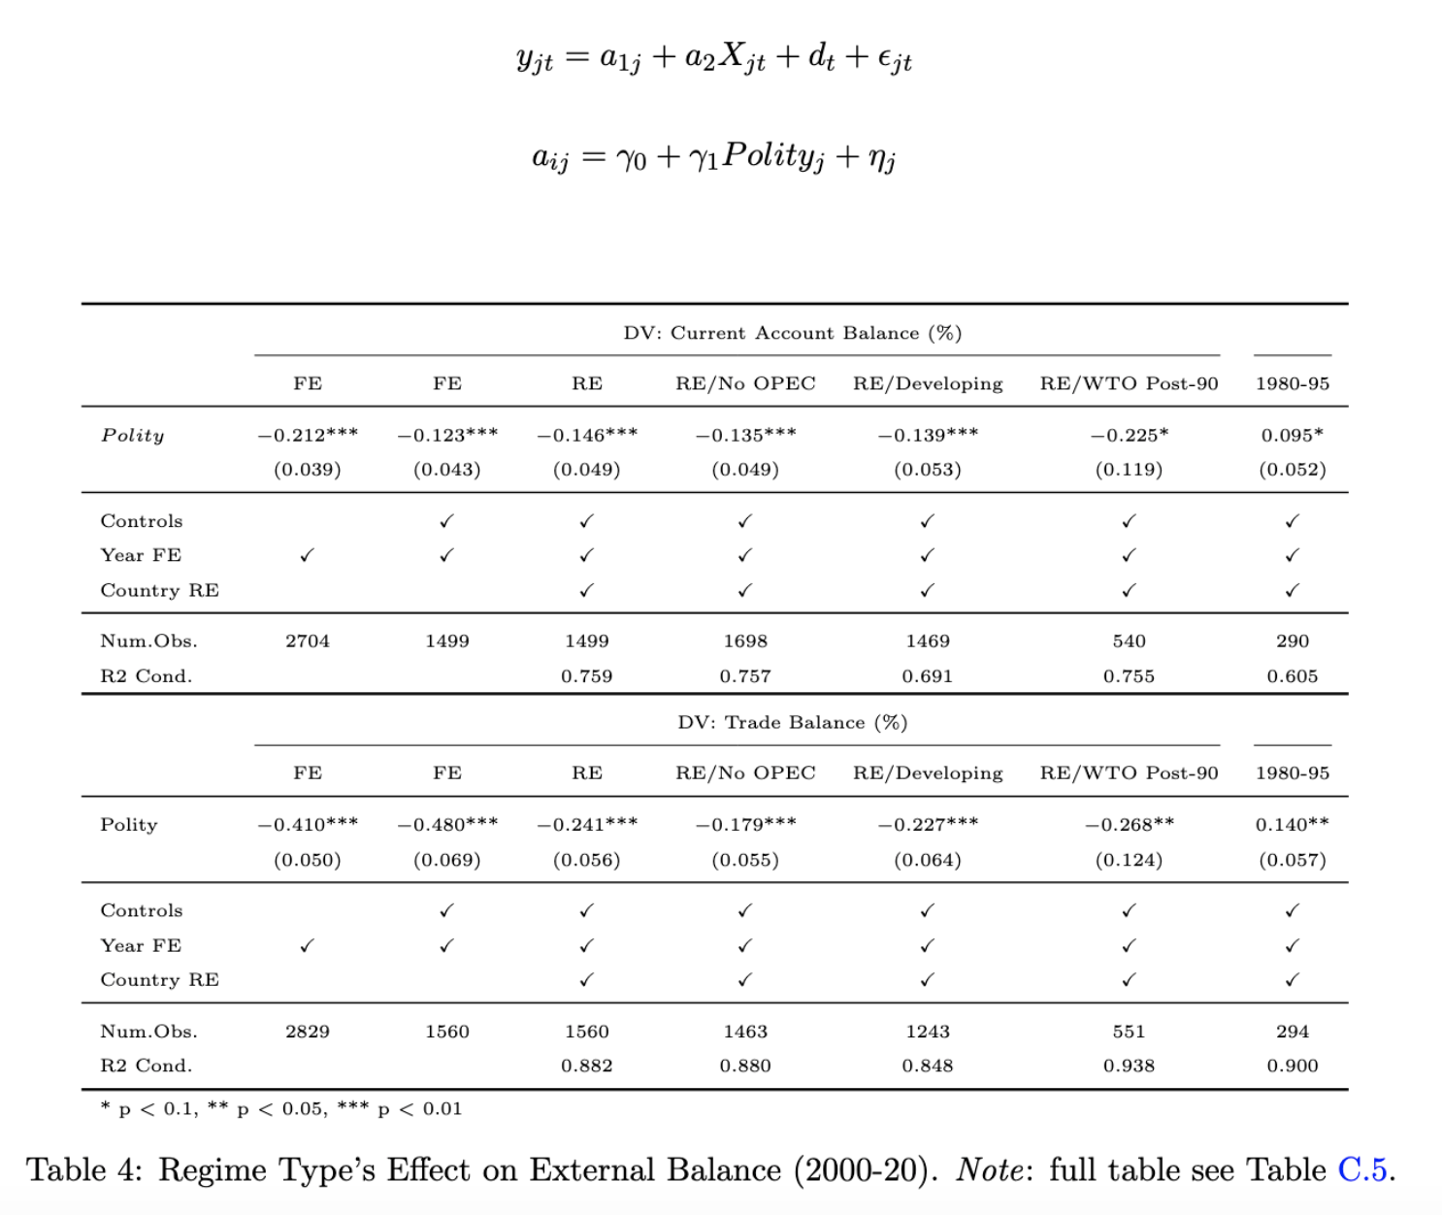
Result 4: External Balance
Hierarchical Model
(Chinn and Ito 2021; Manger and Sattler 2020)

Slide 29
Mechanisms

Slide 30
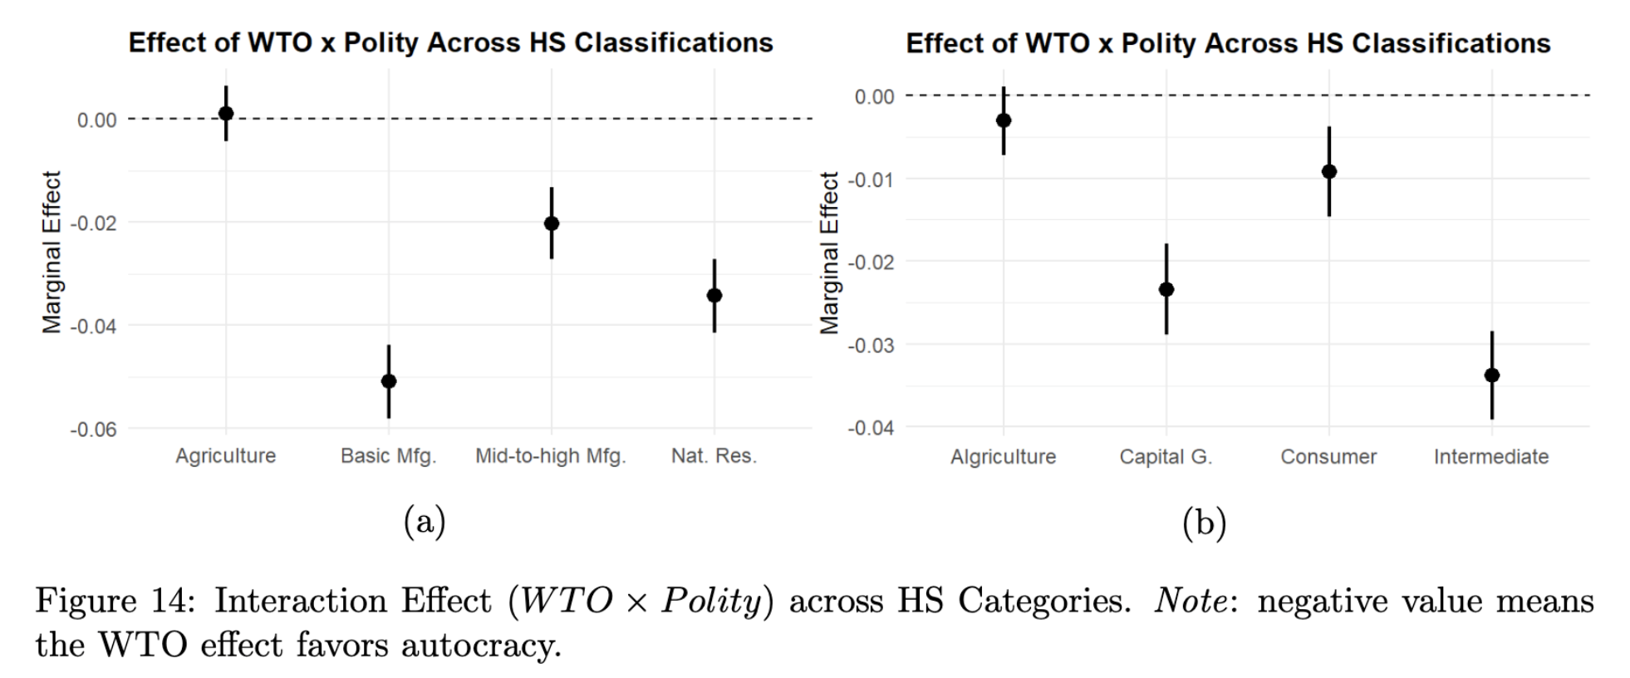
Mechanisms: Sectoral-level Evidence

Slide 31
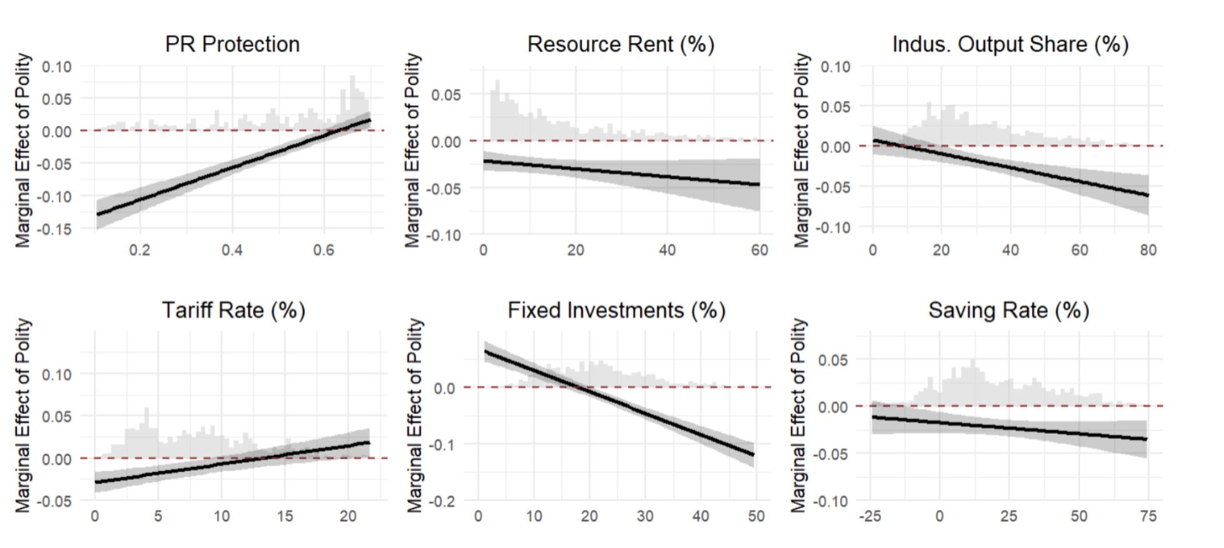
Mechanisms: Mediating Tests

Slide 32
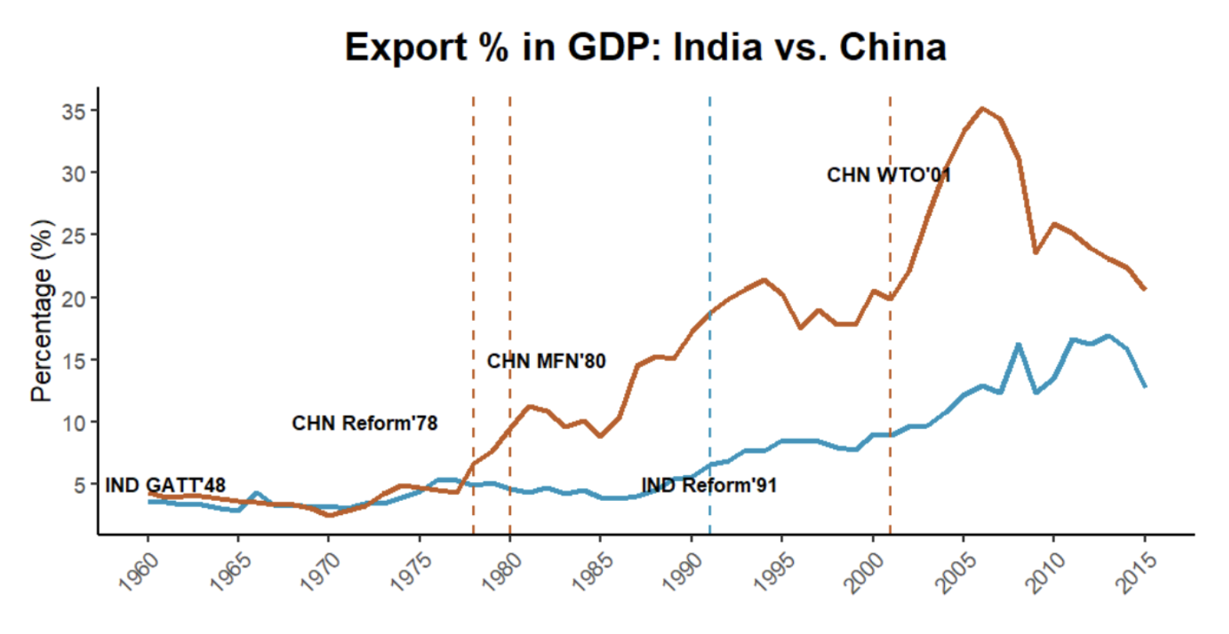
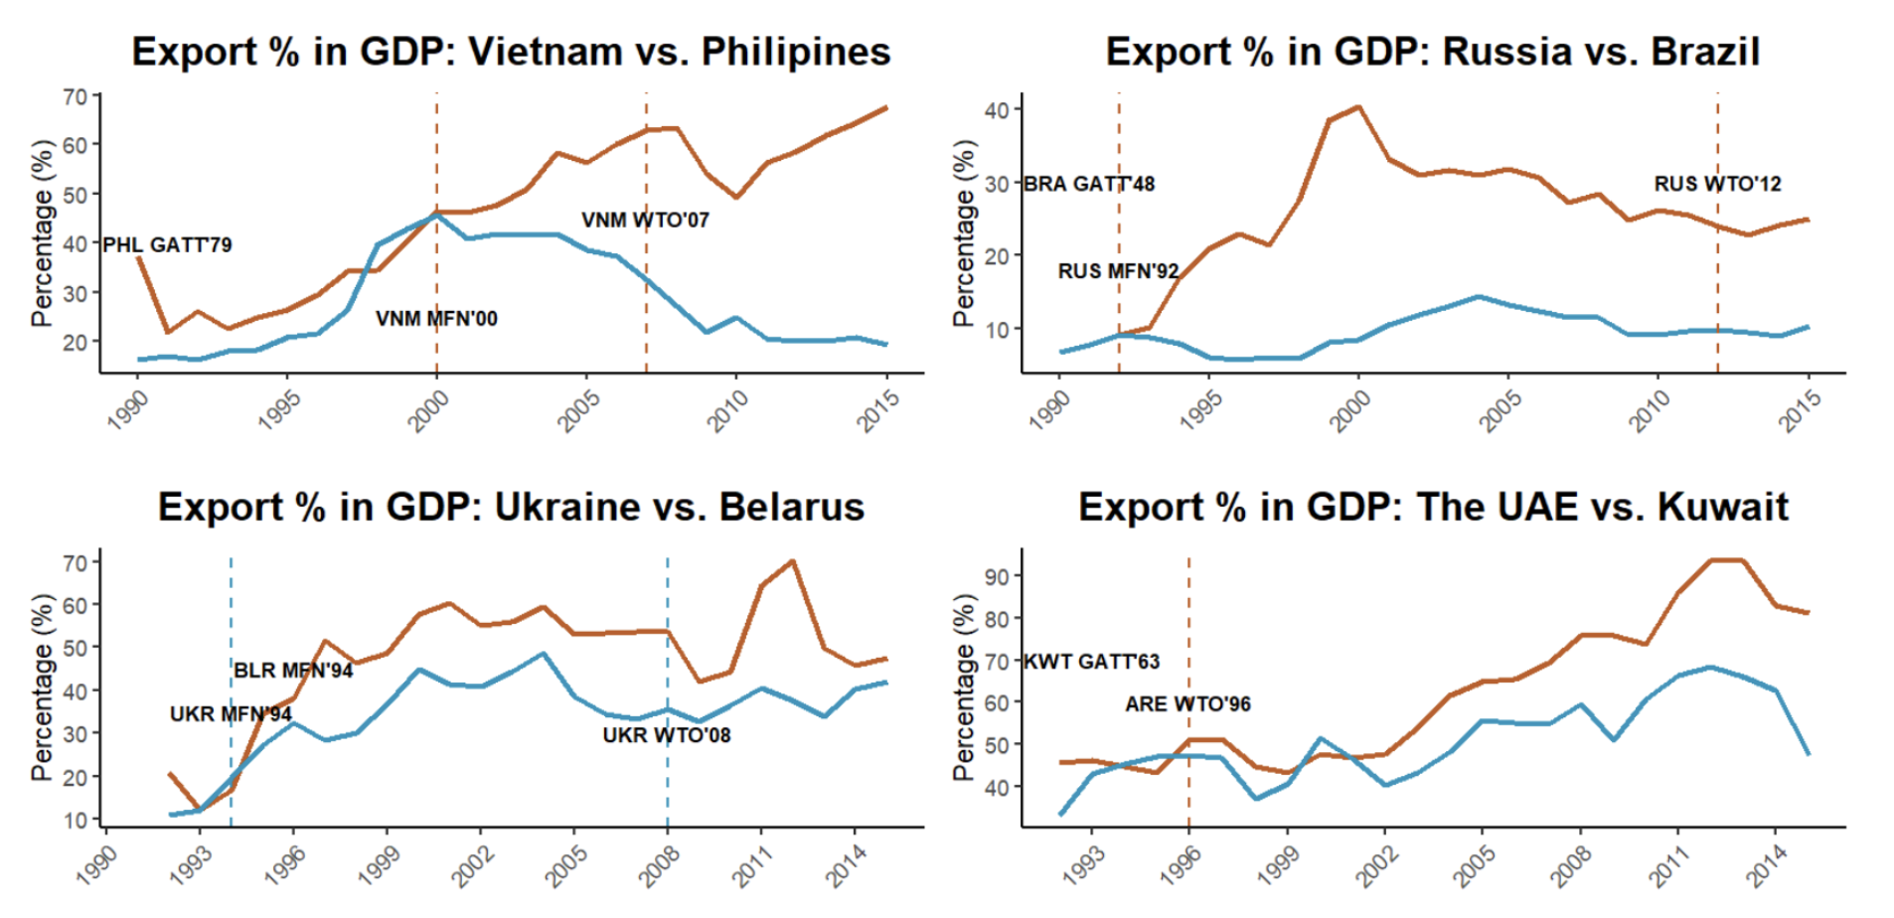
Qualitative Case Comparison
“...China’s political regime allows a gradualist approach which blended state control with market, and long-term planning employing mercantilism (e.g., economic zones and industrial policies) (Lin et al. 2003), as well as the suppression of labor wages…”
“…India’s democratic system, though more inclusive, must navigate coalition politics, public dissent, and legal constraints, resulting in slow decision-making and low mercantilist policies (Groth 2006)…”
See paper for more…

Slide 33
Possible Questions
Selection bias?
Catch-up story?
State capacity?
Democracy-autocracy trade before 1990?
Back-and-forth in GVC?
Spillover and commodity boom?
MFN status?
FDI?

Slide 34
Conclusion
Takeaways:
Autocratic success is unlikely without a globalized economy (related: democratic backsliding)
A theory for global democracy crisis ⇒ external factor (complement Acemoglu et al., Ang…)
If “Trump is the outcome” due to structural causes behind trend – get worse if causes unaddressed
Free trade/globalization is not wrong; policymakers ignored assumptions
Thank you!

